Slide 1


SSF FI Overview
Hoang Quynh Mai
(GS/ACE)
1
Cross Divisional Group - Software, Methods and Tools | CF/COR1 | 19/02/2018
© Robert Bosch GmbH 2016. All rights reserved, also regarding any disposal, exploitation, reproduction, editing, distribution, as well as in the event of applications for industrial property rights.

Slide 2
SSF FI Overview Agenda
SSF FI Overview
SSF FI Benefits
Rollout Plan
Current Usage
Vision 2020
Live Demo
2
Cross Divisional Group - Software, Methods and Tools | GS/ACE | 19/02/2018
© Robert Bosch GmbH 2016. All rights reserved, also regarding any disposal, exploitation, reproduction, editing, distribution, as well as in the event of applications for industrial property rights.

Slide 3
SSF FI Overview Agenda
SSF FI Overview
SSF FI Benefits
Rollout Plan
Current Usage
Vision 2020
Live Demo
3
Cross Divisional Group - Software, Methods and Tools | GS/ACE | 19/02/2018
© Robert Bosch GmbH 2016. All rights reserved, also regarding any disposal, exploitation, reproduction, editing, distribution, as well as in the event of applications for industrial property rights.

Slide 4



SSF FI Overview Why is this topic important for us?
This topic is important for us because …
Worldwide standard operating model for accounting
Financial activities done by Global Service Accounting(GSA) are supported by GPLA and standard IT tools
SSF is a standard tool which is used by all Bosch employees for accounting requests
The tool offers transparency, traceable communication, automation and ERP integration
SSF
4
Cross Divisional Group - Software, Methods and Tools | GS/ACE | 19/02/2018
© Robert Bosch GmbH 2016. All rights reserved, also regarding any disposal, exploitation, reproduction, editing, distribution, as well as in the event of applications for industrial property rights.
Notes:
The goal of the 1A@B project is to implement a worldwide standard operating model for accounting.
The financial activities will be performed by Shared Service Centers (GSA), supported by standard processes (GPLA) and standard tools (e.g. SSF FI, FCC, APM, etc.).
In this new operating model, all Bosch employees (non-accountants & accountants) will interact with SSF FI tool on different complexity/ automation levels, depending on their level of standardization.
Depending on the area of activity, the SSF tool is the technical solution for a clear, transparent and traceable communication as well as the technical support for more automation.

Slide 5
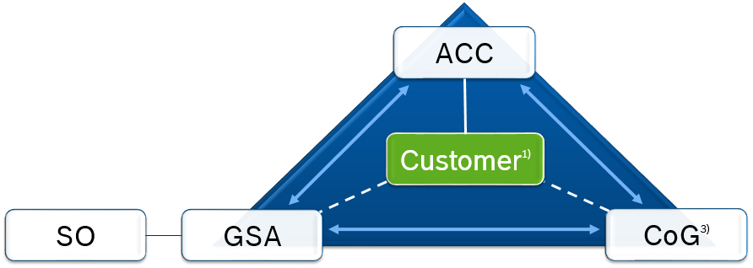
The regional functions
SSF FI Overview
8 regions and 50 countries with specialised accounting functions
Regional Accounting Heads (ACR) coordinate special Accounting tasks in Country Accounting Organisations (ACC)
Germany
Russia
North America
Europe
China
India
Asia Pacific
South America
5
Cross Divisional Group - Software, Methods and Tools | GS/ACE | 19/02/2018
© Robert Bosch GmbH 2016. All rights reserved, also regarding any disposal, exploitation, reproduction, editing, distribution, as well as in the event of applications for industrial property rights.

Slide 6
The Global Service Centres Accounting
SSF FI Overview
We will bundle standard operative accounting tasks in
9 different GSA all over the world
Magdeburg
Suzhou/Chengdu
Country
Germany
Country
China
Timisoara
Country
Romania
San José
Country
Costa Rica
Ho Chi Minh City
Country
Vietnam
Joinville
Bangalore, Coimbatore
Country
Brazil
Country
India
6
Cross Divisional Group - Software, Methods and Tools | GS/ACE | 19/02/2018
© Robert Bosch GmbH 2016. All rights reserved, also regarding any disposal, exploitation, reproduction, editing, distribution, as well as in the event of applications for industrial property rights.

Slide 7
SSF FI Overview Definition of SSF FI terms
SSF FI – Shared Service Framework Finance
Entry channel – How the request is received in SSF FI (e.g. e-mail)
Self Service – BGN access, where an employee can raise a request
Service Request (SR) – Customer inquiry transformed into SSF FI ticket
Service Team – The team who handles the request
GPLA – Global Processes Library Accounting
7
Cross Divisional Group - Software, Methods and Tools | GS/ACE | 19/02/2018
© Robert Bosch GmbH 2016. All rights reserved, also regarding any disposal, exploitation, reproduction, editing, distribution, as well as in the event of applications for industrial property rights.
Notes:
Explanations of abbreviation

Slide 8



SSF FI Overview Overview about the tool
Requester
Company Code
Customer
Vendor
Employee
Outgoing inquiries
Incoming inquiries
Entry channels
Telephone, e-mail
Self service (BGN Portal)
SSF FI
GSA
employee
ACC/ACR
employee
ACE
employee
PMD
Communication
Service Request handling
(Service Level Agreement):
Status follow up
Prioritization
Categorization
Routing
BI Reporting
Single Sign On
Vendor/Customer Factsheet
COMPAS
Process steering
AWA
Log of changes
ERP
APM
8
Cross Divisional Group - Software, Methods and Tools | GS/ACE | 19/02/2018
© Robert Bosch GmbH 2016. All rights reserved, also regarding any disposal, exploitation, reproduction, editing, distribution, as well as in the event of applications for industrial property rights.
Notes:
This is one of the most important slides. It shows all system characteristics of SSF:
Who can raise Service Requests
Which entry channels are available
SSF receives master data from PMD, Compass and other master data systems
SSF is connected to the ERP systems (for silver+gold only in Transaction Launcher, for diamond incl. posting and archiving)
SSF itself can provide: communication platfrom, Single Sign ON etc. – but the benefits of SSF will be explained on a later slide

Slide 9
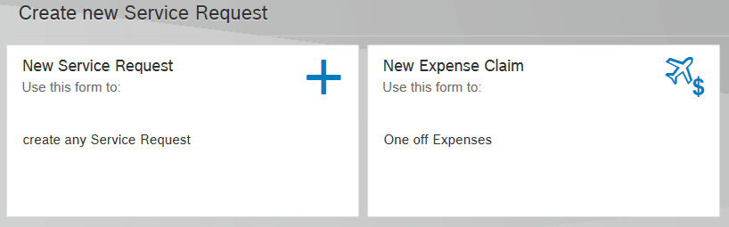
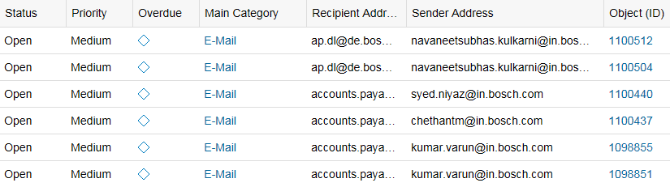

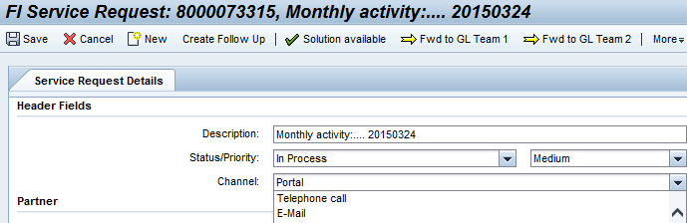
SSF FI Overview Entry channels
Starting point – entry channels and Service Request creation
Self service
BGN portal
SSF Self service
BGN Portal
Employee
External
SSF
Inbox
Telephone
Manual creation of FI SR in SSF
9
Cross Divisional Group - Software, Methods and Tools | GS/ACE | 19/02/2018
© Robert Bosch GmbH 2016. All rights reserved, also regarding any disposal, exploitation, reproduction, editing, distribution, as well as in the event of applications for industrial property rights.

Slide 10
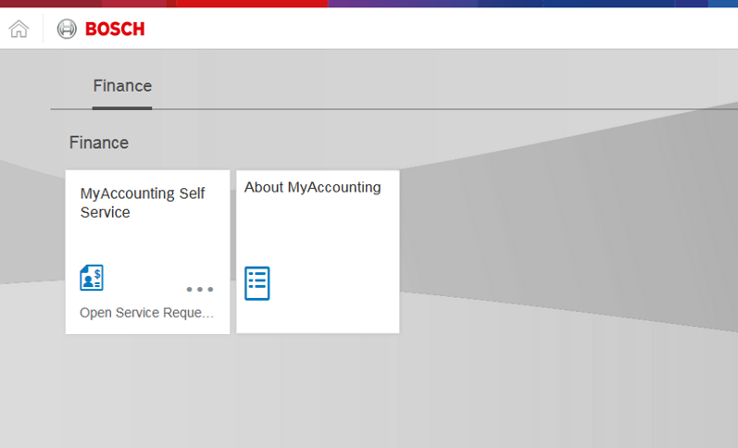
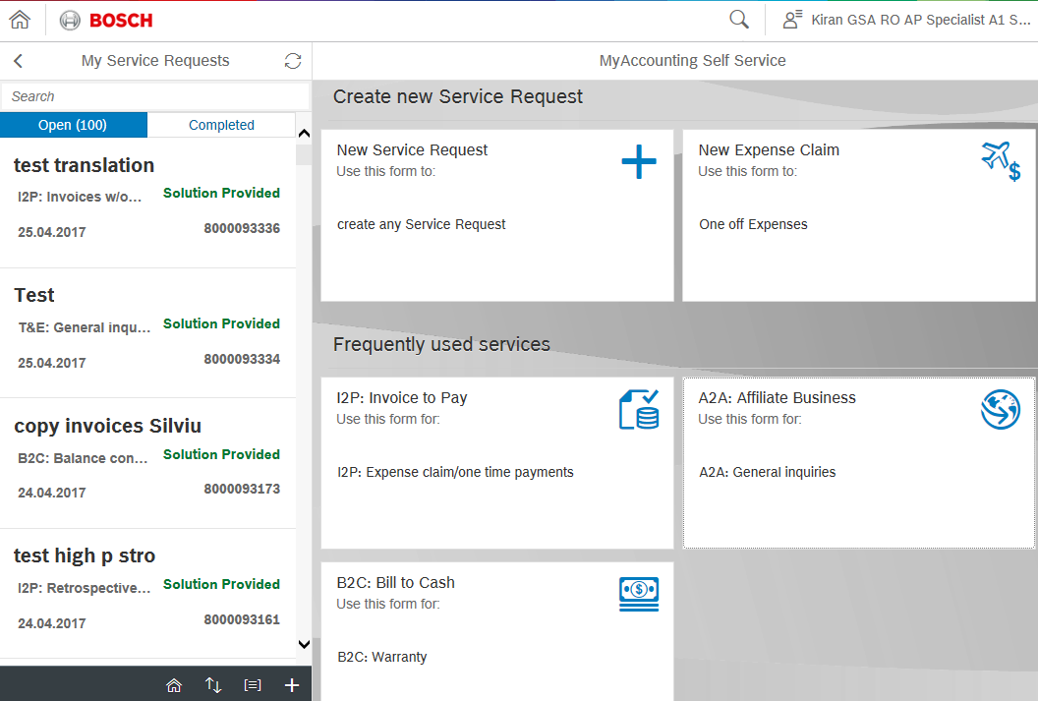
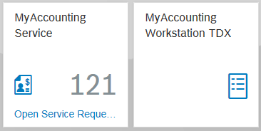
SSF FI Overview Self-Service Screen
Launchpad
= the new entry to SSF FI
SSF 2.0
= the UX-optimized Version of SSF FI
How can I access SSF FI?
How does the new SSF FI look ?
Provide
feedback
10
Cross Divisional Group - Software, Methods and Tools | GS/ACE | 19/02/2018
© Robert Bosch GmbH 2016. All rights reserved, also regarding any disposal, exploitation, reproduction, editing, distribution, as well as in the event of applications for industrial property rights.

Slide 11
SSF FI Overview Classification of SSF FI processes
Prerequisite
(process view)
Harmonized
GPLA level 4
Harmonized
GPLA level 5
Harmonized
(partly) system landscape
Communication framework
Silver
Gold
Diamond
Standardization on service title level
(GPLA level 4)
Manual workflow functionality
Standardization on activity level
(GPLA level 5)
Automatic workflow
& Structured Inputs
Automatic workflow
& Structured Inputs
No integration with ERP systems
Not dependent on the IT landscape of the entity
SSF FI Processes automated or with integration to ERP systems
Increasing implementation complexity
11
Cross Divisional Group - Software, Methods and Tools | GS/ACE | 19/02/2018
© Robert Bosch GmbH 2016. All rights reserved, also regarding any disposal, exploitation, reproduction, editing, distribution, as well as in the event of applications for industrial property rights.
Notes:
As we follow the lift-drop-change approach in the project 1A@B, we have SSF roll outs for more or less standardized processes.
So, we have processes with different majurity level in SSF: silver with dummy steps (create, check, close request) but no automatic postings on ERP, gold with process steps according to the GPLA level 5 and diamond processes with automation and validation against the ERP systems.
→ Silver processes are used mostly, only China uses gold processes and only BBM-GmbH uses diamond currently

Slide 12
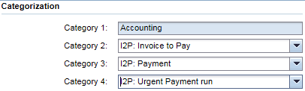
SSF FI Overview Standardization of SSF FI processes
SSF FI silver processes versus GPLA
GPLA Category
SSF Category
Service category 1
Service category 2
Service category 3
Service category 4
GPLA L1
GPLA L2
GPLA L3
GPLA L4
Business process
Main process
Sub-
process
Service
Accounting
I2P
Payment
Standard pymt run
I2D
Urgent pymt run
Disposition
Asset sale
B2R
Asset scrapping
Postings
Journal entry post.
Recurr. journal entry
12
Cross Divisional Group - Software, Methods and Tools | GS/ACE | 19/02/2018
© Robert Bosch GmbH 2016. All rights reserved, also regarding any disposal, exploitation, reproduction, editing, distribution, as well as in the event of applications for industrial property rights.
Notes:
As GPLA presentation is mostly in presented upfront: this is about the linkage of GPLA to SSF:
The GPLA level 1-4 is reflected in the ticket category.
As mentioned for previous slide, level 5 is reflected in the steps to be performed per Service Request.

Slide 13
SSF FI Overview Agenda
SSF FI Overview
SSF FI Benefits
Rollout Plan
Current Usage
Vision 2020
Live Demo
13
Cross Divisional Group - Software, Methods and Tools | GS/ACE | 19/02/2018
© Robert Bosch GmbH 2016. All rights reserved, also regarding any disposal, exploitation, reproduction, editing, distribution, as well as in the event of applications for industrial property rights.

Slide 14

SSF FI Overview Benefits of SSF FI
Benefits of silver processes (1)
“Lift-Drop-Change”-Compatibility
Enable the accountants to use SSF FI right after organizational transition to GSA
Service center management
Tool for shared service centers offering transparency and traceability of communication
Communication management
Offer communication functionality via SSF FI self service, manual e-mail and tickets
Service delivery
Automatic or manual routing of requests from customers to the correct service team
14
Cross Divisional Group - Software, Methods and Tools | GS/ACE | 19/02/2018
© Robert Bosch GmbH 2016. All rights reserved, also regarding any disposal, exploitation, reproduction, editing, distribution, as well as in the event of applications for industrial property rights.
Notes:
These are the benefits of SSF, if silver processes are in use.

Slide 15
SSF FI Overview Benefits of SSF FI
Benefits of silver processes (2)
Automation
Launch different SAP systems and transaction codes via Single Sign On
Automatic e-mail notifications to Bosch employees
Real time tracking of Service Requests
Analytics
BI Reporting functionality can be used to generates reports and analysis on service delivery
15
Cross Divisional Group - Software, Methods and Tools | GS/ACE | 19/02/2018
© Robert Bosch GmbH 2016. All rights reserved, also regarding any disposal, exploitation, reproduction, editing, distribution, as well as in the event of applications for industrial property rights.

Slide 16

SSF FI Overview Benefits of SSF FI
Benefits of Gold processes
All benefits of Silver processes
Governance and compliance
Requests are processed according to GPLA
Structured inputs
Request details are collected in the process specific fields
Automatic Approval Workflow
Approval Workflow is triggered automatically based on cost center and process
Future integration with AWA, i.e no maintenance in SSF is required
16
Cross Divisional Group - Software, Methods and Tools | GS/ACE | 19/02/2018
© Robert Bosch GmbH 2016. All rights reserved, also regarding any disposal, exploitation, reproduction, editing, distribution, as well as in the event of applications for industrial property rights.
Notes:
Additional benefits, if gold or diamond are in use.

Slide 17

SSF FI Overview Benefits of SSF FI
Benefits of Diamond processes
All benefits of Silver & Gold processes (except GPLA compliance)
ERP Automation
Automatic data retrieving from ERP system(s)
Automatic postings from SSF FI to different ERP systems
Automatic archiving on ERP systems
17
Cross Divisional Group - Software, Methods and Tools | GS/ACE | 19/02/2018
© Robert Bosch GmbH 2016. All rights reserved, also regarding any disposal, exploitation, reproduction, editing, distribution, as well as in the event of applications for industrial property rights.
Notes:
Additional benefits, if gold or diamond are in use.

Slide 18
SSF FI Overview Agenda
SSF FI Overview
SSF FI Benefits
Rollout Plan
Current Usage
Vision 2020
Live Demo
18
Cross Divisional Group - Software, Methods and Tools | GS/ACE | 19/02/2018
© Robert Bosch GmbH 2016. All rights reserved, also regarding any disposal, exploitation, reproduction, editing, distribution, as well as in the event of applications for industrial property rights.

Slide 19
SSF FI Rollouts - Roadmap 2019
ROLLOUTS
Previous Rollouts | 2019
Europe AA-AS (DE), RB GmbH (DE), RBOS (AT), BGAT (AT), DCAT (AT), RBGB (GB), RBIE (IE), RBGH (GB), TTGB (GB), DCGB (GB), STGB (GB), STRO (RO), RBRO (RO), PTIT (IT), DCIT (IT), RBHU (HU), DCHU (HU), RBVB (GB), DCBE (BE), DCCH (CH), RBCH (CH), RBSC (CH), RBSW (SE), RBNO (NO), RBFI (FI), RBDK (DK), DCSW (SE), DCNO (NO), DCFI (FI), DCDK (DK), STFR (FR), DCES (ES), DCSI (SI), RBSI (SI), PTHU (HU), DCNL (NL), DCTR (TR), TTCH (CH),
China DCCC, DCCX, PACN, DCCB, RBCD, RBCW, DCCS, PTCN, RBHK, SXCN
APAC DCSG (SG), DCHK (HK), RBJP (JP), PTMA (MA), DCKR (KR), DCMY (MY), RBVN (VN)
Latin America RBLA (BR)
India DCIN, RBAI, RBEI, RBDI
Jan. | Feb. | Mar. | April | May | June | July | Aug | Sept. | Oct. | Nov. | Dec.
Spain, Belgium, Vietnam (EUR14)
BSES, TTBE, BTVN
Germany (GER02)
BCDS, BESG, BHCS, HOME, CECO, CODE, RBVC, BSOT…
United States, Mexico, Canada (NAM01)
FA: RBNA, RBFS, DCUS, STNA, PTNA, RBMX, DCCA, RBCA, DCCA
China (CN10)
RBCN, RBCT
Germany (GER03)
ETAS, PTDE, GROW, RB GmbH AA, PEBGIT, PEETIT, PERBRIT, PERBIT
India (IND03)
RBIN, RBIC
ARG. BRA, CHL, COL, ECU, PAN, PRY, PER, URY, VEN ( LA02)
RBIN, RBIC
RBAR, BISB, ASBR, RBCL, DCCL, RBCO, RBEQ, RBPC, RBPY, RBPE, RBUY, RBVE
Netherland, France, Czech Rep., Italy, Romania, Korea (EUR15)
STNL, DCFR, DCFD, RBCB, CVIT, TDIT, RBNT, RBKB
China (CN11)
AACN, TBD
Germany (GER04)
Rb GmbH CM, TTDE, RBDB, RBLF, RBCM, PADM
United States (NAM02)
Other processes: RBNA, RBFS, DCUS, STNA, PTNA, RBMX, DCCA, RBCA, DCCA
Spain, Portugal, Hungary, France, Czech R., Turkey, Malaysia, Indonesia, Australia ( EUR16)
RBES, RNPO, RBHH, RBFR, SOFR, RBRO, RBCJ (02/2020), RBTR (02/2020), RBMA, DCID, RBAU
76 legal entities
19
Cross Divisional Group - Software, Methods and Tools | CF/ACE7 | 19/02/2018
© Robert Bosch GmbH 2016. All rights reserved, also regarding any disposal, exploitation, reproduction, editing, distribution, as well as in the event of applications for industrial property rights.

Slide 20
SSF FI Overview Agenda
SSF FI Overview
SSF FI Benefits
Rollout Plan
Current Usage
Vision 2020
Live Demo
20
Cross Divisional Group - Software, Methods and Tools | CF/ACS | 19/02/2018
© Robert Bosch GmbH 2016. All rights reserved, also regarding any disposal, exploitation, reproduction, editing, distribution, as well as in the event of applications for industrial property rights.

Slide 21
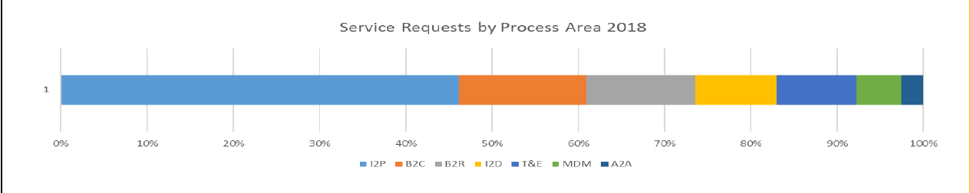
SSF FI Overview Current Usage
21
Cross Divisional Group - Software, Methods and Tools | CF/ACE | 19/02/2018
© Robert Bosch GmbH 2016. All rights reserved, also regarding any disposal, exploitation, reproduction, editing, distribution, as well as in the event of applications for industrial property rights.
Notes:
1 Month TL
2 Region TR
3 Process Area LL
4 Class LR

Slide 22
SSF FI Overview Agenda
SSF FI Overview
SSF FI Benefits
Rollout Plan
Current Usage
Vision 2020
Live Demo
22
Cross Divisional Group - Software, Methods and Tools | CF/ACS | 19/02/2018
© Robert Bosch GmbH 2016. All rights reserved, also regarding any disposal, exploitation, reproduction, editing, distribution, as well as in the event of applications for industrial property rights.

Slide 23
SSF FI Overview Vision 2020
2020 – 20xx (Transform)
Leverage full automation potential
Leverage SAP centric enabling technologies e.g.
BPMD, MDG, S/4HANA
Leverage Bosch initiatives e.g.
supplier portal, travel 4.0, POE only
Leverage automation capabilities of
ITPA (IT process automation)
RPA (Robotic Process Automation)
2019 (Optimize)
World view & smart processes
Increase efficiency of processes for handling of service requests
Usage driven automation of repetitive tasks
Implement SSF in North America
Automation and Integration with ERP backend systems
2018 (Enable)
Realize “must haves” & Automate
Pilot SSF-FI Robotics and Automation
Process Automation (RPA) for SSF FI
Increase appropriate usage of SSF (ACCs & GSAs)
Streamline current SSF services
Increase robustness of SSF
Improve performance, reduce defects
Intensify SSF trainings
Ongoing roll-out of SSF tool during transitions
23
Cross Divisional Group - Software, Methods and Tools | CF/ACS | 19/02/2018
© Robert Bosch GmbH 2016. All rights reserved, also regarding any disposal, exploitation, reproduction, editing, distribution, as well as in the event of applications for industrial property rights.

Slide 24
SSF FI Overview Agenda
SSF FI Overview
SSF FI Benefits
Rollout Plan
Current Usage
Vision 2020
Live Demo
24
Cross Divisional Group - Software, Methods and Tools | CF/ACS | 19/02/2018
© Robert Bosch GmbH 2016. All rights reserved, also regarding any disposal, exploitation, reproduction, editing, distribution, as well as in the event of applications for industrial property rights.

Slide 25
SSF FI Overview SSF Live Demo
Create a Service Request from Self-Service Screen by Bosch employee
Process the Service Request by GSA Agent
25
Cross Divisional Group - Software, Methods and Tools | CF/ACS | 19/02/2018
© Robert Bosch GmbH 2016. All rights reserved, also regarding any disposal, exploitation, reproduction, editing, distribution, as well as in the event of applications for industrial property rights.

Slide 26
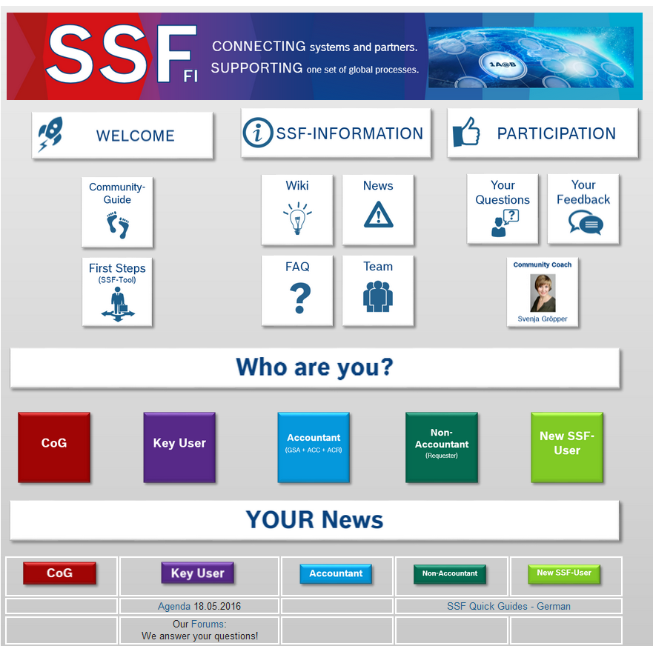
SSF FI Overview Community @ BoschConnect
In this SSF Community Page, you can
Post question to SSF Team
Create Group discussion via Forum
Access to SSF Rollout Plan
Access to System Development Plan and Training Materials
Self-learn Tips & Tricks
26
Cross Divisional Group - Software, Methods and Tools | CF/ACS | 19/02/2018
© Robert Bosch GmbH 2016. All rights reserved, also regarding any disposal, exploitation, reproduction, editing, distribution, as well as in the event of applications for industrial property rights.
Notes:
For more information, please visit our BoschConnect Community.

Slide 27
SSF FI Overview SSF Bulletin
27
Cross Divisional Group - Software, Methods and Tools | CF/ACS | 19/02/2018
© Robert Bosch GmbH 2016. All rights reserved, also regarding any disposal, exploitation, reproduction, editing, distribution, as well as in the event of applications for industrial property rights.
Notes:
For more information, please visit our BoschConnect Community.

Slide 28

SSF FI Overview
28
Cross Divisional Group - Software, Methods and Tools | CF/ACS | 19/02/2018
© Robert Bosch GmbH 2016. All rights reserved, also regarding any disposal, exploitation, reproduction, editing, distribution, as well as in the event of applications for industrial property rights.

Slide 29
Back-up Slides
29
Cross Divisional Group - Software, Methods and Tools | CF/ACS | 19/02/2018
© Robert Bosch GmbH 2016. All rights reserved, also regarding any disposal, exploitation, reproduction, editing, distribution, as well as in the event of applications for industrial property rights.

Slide 30
Key data
SSF FI Overview
No. of entities world wide – 684 ( in scope ~ 400 )
No. of ERP systems ~ 100 (of which SAP ~ 60)
No. of SSF Clients – 1 (PDX)
No. of process areas – 7
Invoice to Pay, Bill to Cash, Book to Report, Investment to Disposal, Travel & Expense and Master data Management, Affiliate to Affiliate business
Total No. Of processes - 169
Processes with no ERP integration - 129
Processes with ERP integration – 40
Processes with self service activated -67
30
Cross Divisional Group - Software, Methods and Tools | CF/ACS | 19/02/2018
© Robert Bosch GmbH 2016. All rights reserved, also regarding any disposal, exploitation, reproduction, editing, distribution, as well as in the event of applications for industrial property rights.

Slide 31
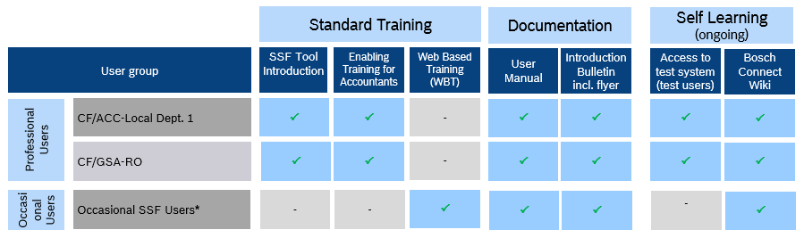
Trainings
SSF FI Overview
31
Cross Divisional Group - Software, Methods and Tools | CF/ACS | 19/02/2018
© Robert Bosch GmbH 2016. All rights reserved, also regarding any disposal, exploitation, reproduction, editing, distribution, as well as in the event of applications for industrial property rights.

Slide 32
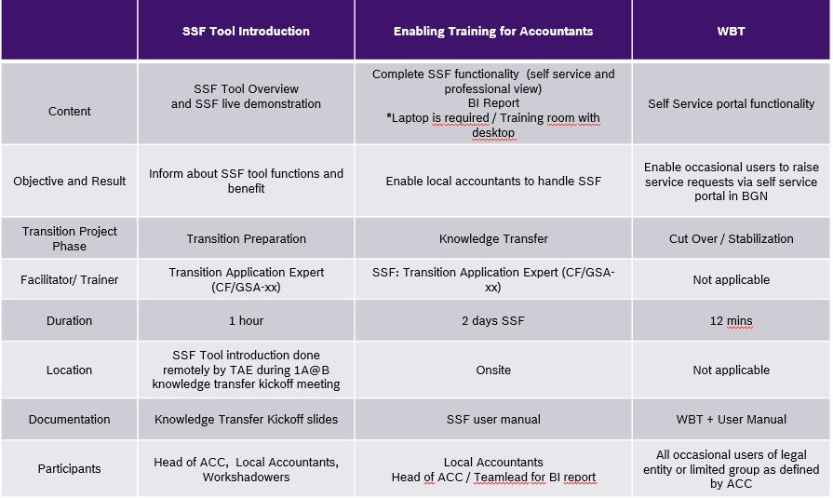
Trainings
SSF FI Overview
32
Cross Divisional Group - Software, Methods and Tools | CF/ACS | 19/02/2018
© Robert Bosch GmbH 2016. All rights reserved, also regarding any disposal, exploitation, reproduction, editing, distribution, as well as in the event of applications for industrial property rights.

